Slide 1
DiscoverIT Internship Detection App
George Patrașc
Ferencz Cârnu

Slide 2
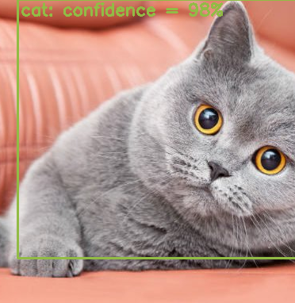
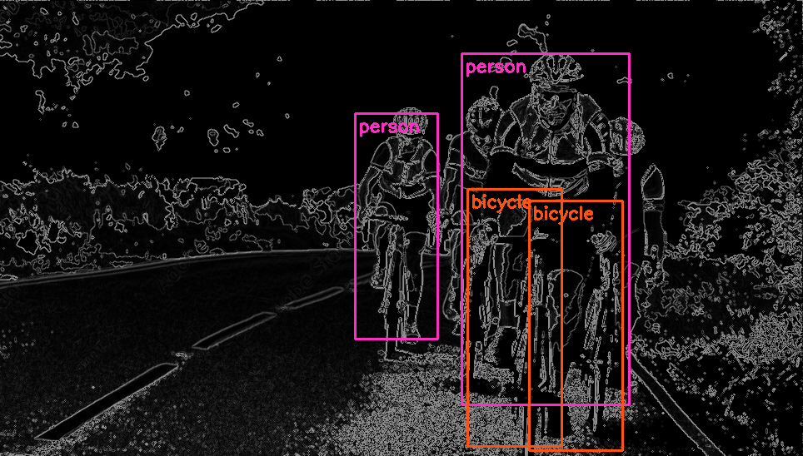
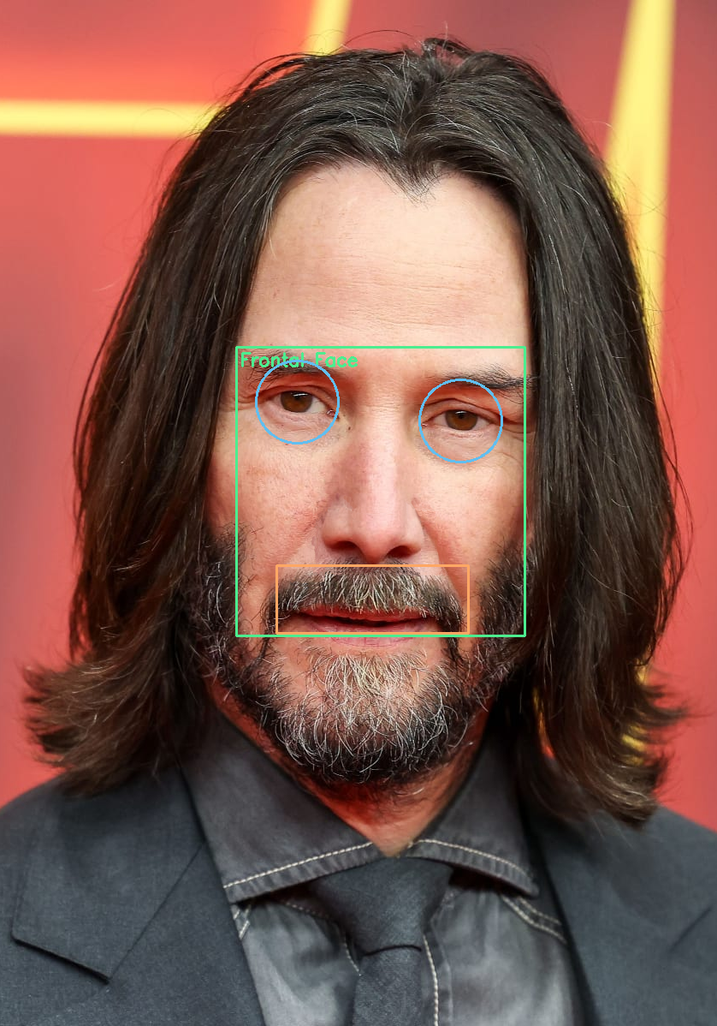
Desktop application to showcase the use of object detection models

Slide 3
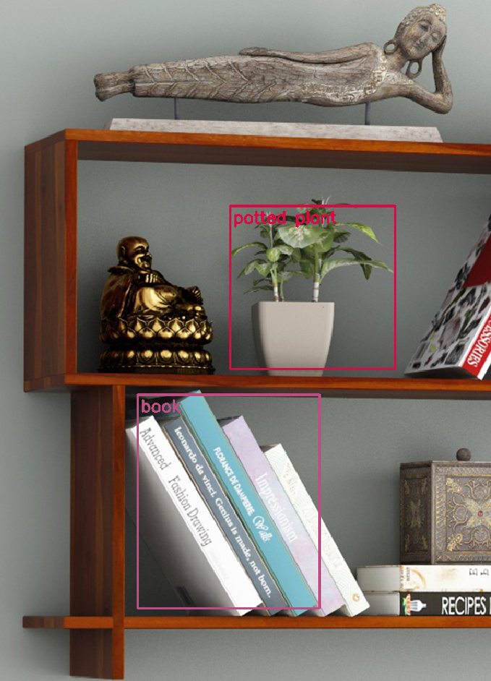








Used Technologies
C++ Language
OpenCV
Qt 6
CMake
Visual Studio
Python
Ultralytics
GitLab

Slide 4
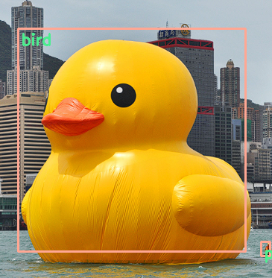
Application Overview
Our application allows users to:
interact with a webcam
capture video feed
upload still images
Users can load local model files and apply object detection to analyze the images.
They can explore basic image processing algorithms to enhance and see how they can affect the results.

Slide 5
Architecture
GUI
Main window
Menu
Status bar
The application follows a straightforward architecture
Separate components for
Graphical User Interface
Webcam interaction
Image processing
Object detection
Application
Detection
Cascade Classifiers or Neural Networks
Utils
Image processing algorithms
Frame status logic (undo/redo)

Slide 6
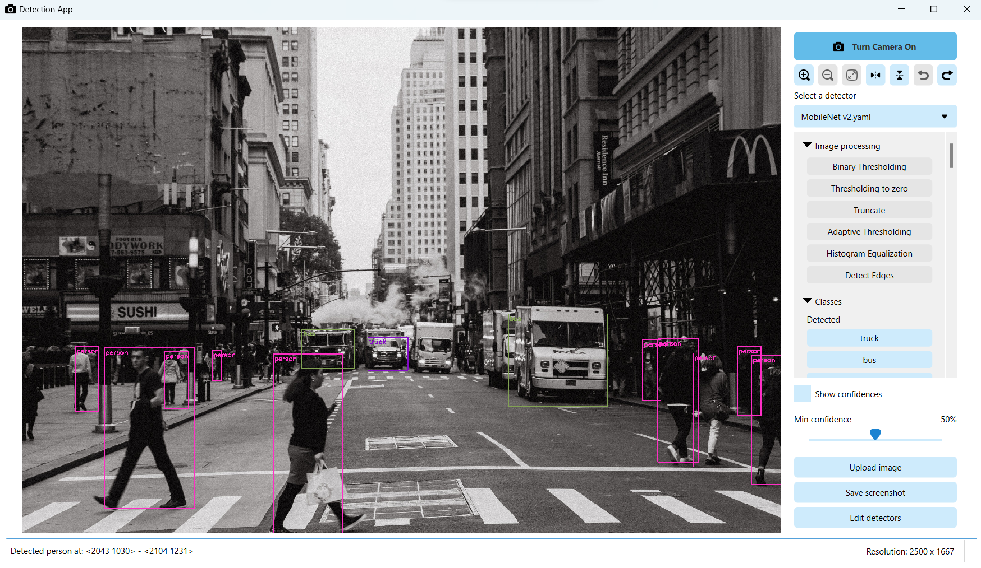
User Interface
Created with the C++ Qt Library
Styled using the QSS syntax
Components:
Image viewer
reimplemented Qt’s QGraphicsView
Custom menu QWidget
custom checkable buttons
scrollable list of image processing algorithms and available objects to detect (you can enable/disable) them
Status bar

Slide 7
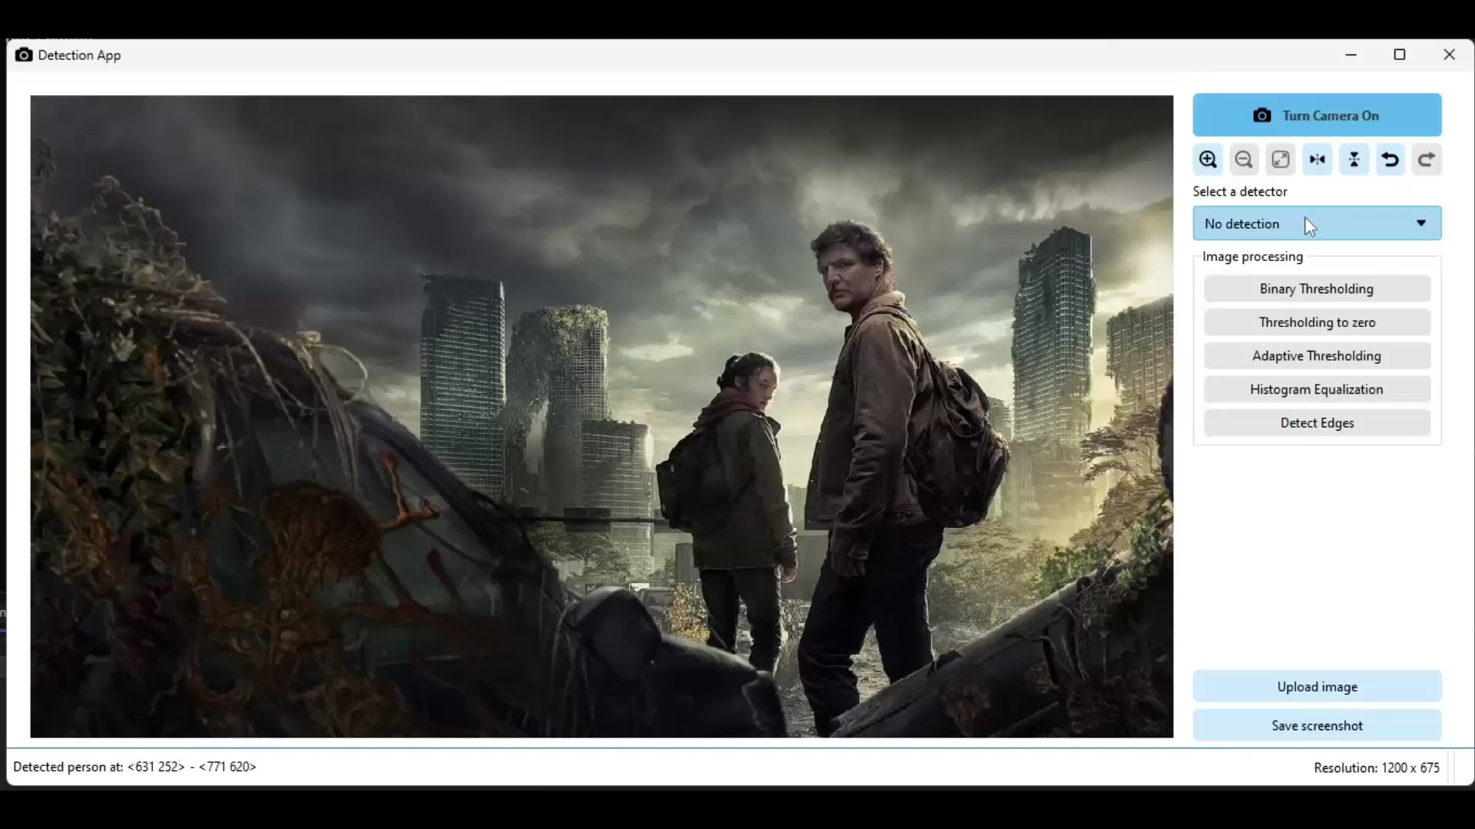
Object Detection
Cascade Classifier
single-object detector
uses haarcascades or lbpcascades
Neural Networks
multi-object detection
Requires three files: model, classes, config
You can enable/disable certain object
You can adjust the minimum-threshold

Slide 8
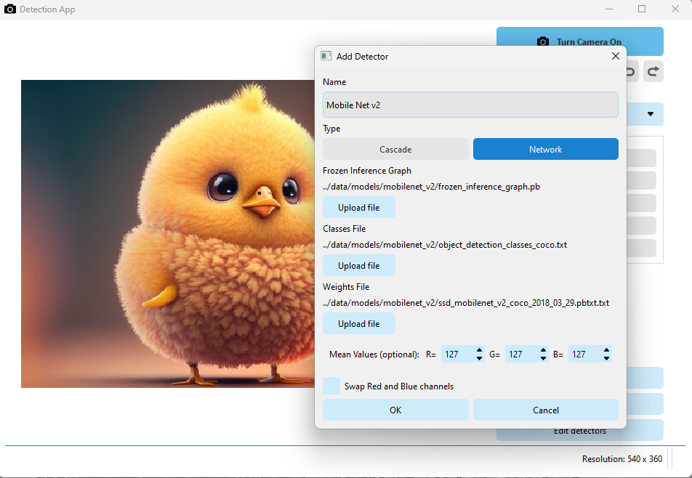

Model Loading
You can add models and specify the following properties:
Type (cascade or network)
The path(s) of the model
The mean values for the model (optional)
Whether to swap the red and blue channels (optional)
Each detector is saved in “*.yaml” file in the “detector_paths” directory.

Slide 9

Image Processing
There are different filters to enhance the image:​
Binary Thresholding​
Thresholding to zero​
Truncate​
Adaptive Thresholding​
Histrogram Equalization​
Detect Edges

Slide 10
ObjectDetection library
Follows SOLID principles:
Single responsibility principle
Open/closed principle
Liskov Substitution principle
Interface Segregation principle
Dependency inversion principle
Serializable
Detector
Threshold Adjuster
Cascade Classifier
Neural Network
ONNX Detector

Slide 11
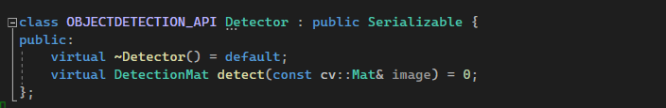
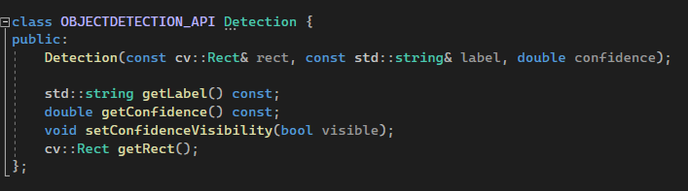
Single Responsibility Principle
“A class should have one, and only one, reason to change.”
The only reason our Detector class should ever change is to change the way detection works.
The way the output is interpreted is the responsibility of another class.
S

Slide 12
Open/Closed Principle
“Objects or entities should be open for extension but closed for modification.”
Changing classes can lead to bugs or problems. Instead of modifying our Detector classes to suit new needs, extension is preferred, which allows us to provide a different way of detection, without affecting what already works.
O
Detector
Cascade Classifier
Neural Network
Some New Type

Slide 13
Liskov Substitution Principle
“If class A is a subtype of class B, we should be able to replace B with A without disrupting the behavior of our program.”
While the Neural Network Detector class offers a way to use those networks for detection, the ONNX Detector is a subclass specifically for ONNX models. If a function requires a ONNX Detector, the parent class will still get the job done.
L
Neural Network
Neural Network
Insert ONNX Detector, please!
ONNX Detector
ONNX Detector
ONNX Detector

Slide 14
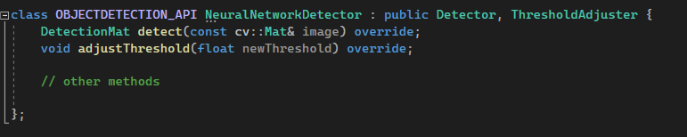
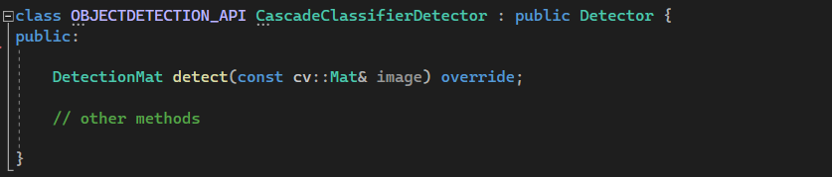
Interface Segregation Principle
“Clients should not be forced to depend on interfaces they don't use.”
Since Cascade Classifiers do not offer a way to check the confidence of a detection, we shouldn’t bloat the class with a Minimum Confidence (Threshold) Adjuster that it will not use.
I

Slide 15
Dependency Inversion Principle
“High-level modules should not depend on low-level modules; both should depend on abstractions.”
Instead of our application depending on different detector types that may have different behaviors, it depends on a single Detector abstraction, which acts as a fixed contract that states the base behavior all concrete classes will obey.
D
Application
Cascade Classifier
Detector
Neural Network
Some New Type

Slide 16
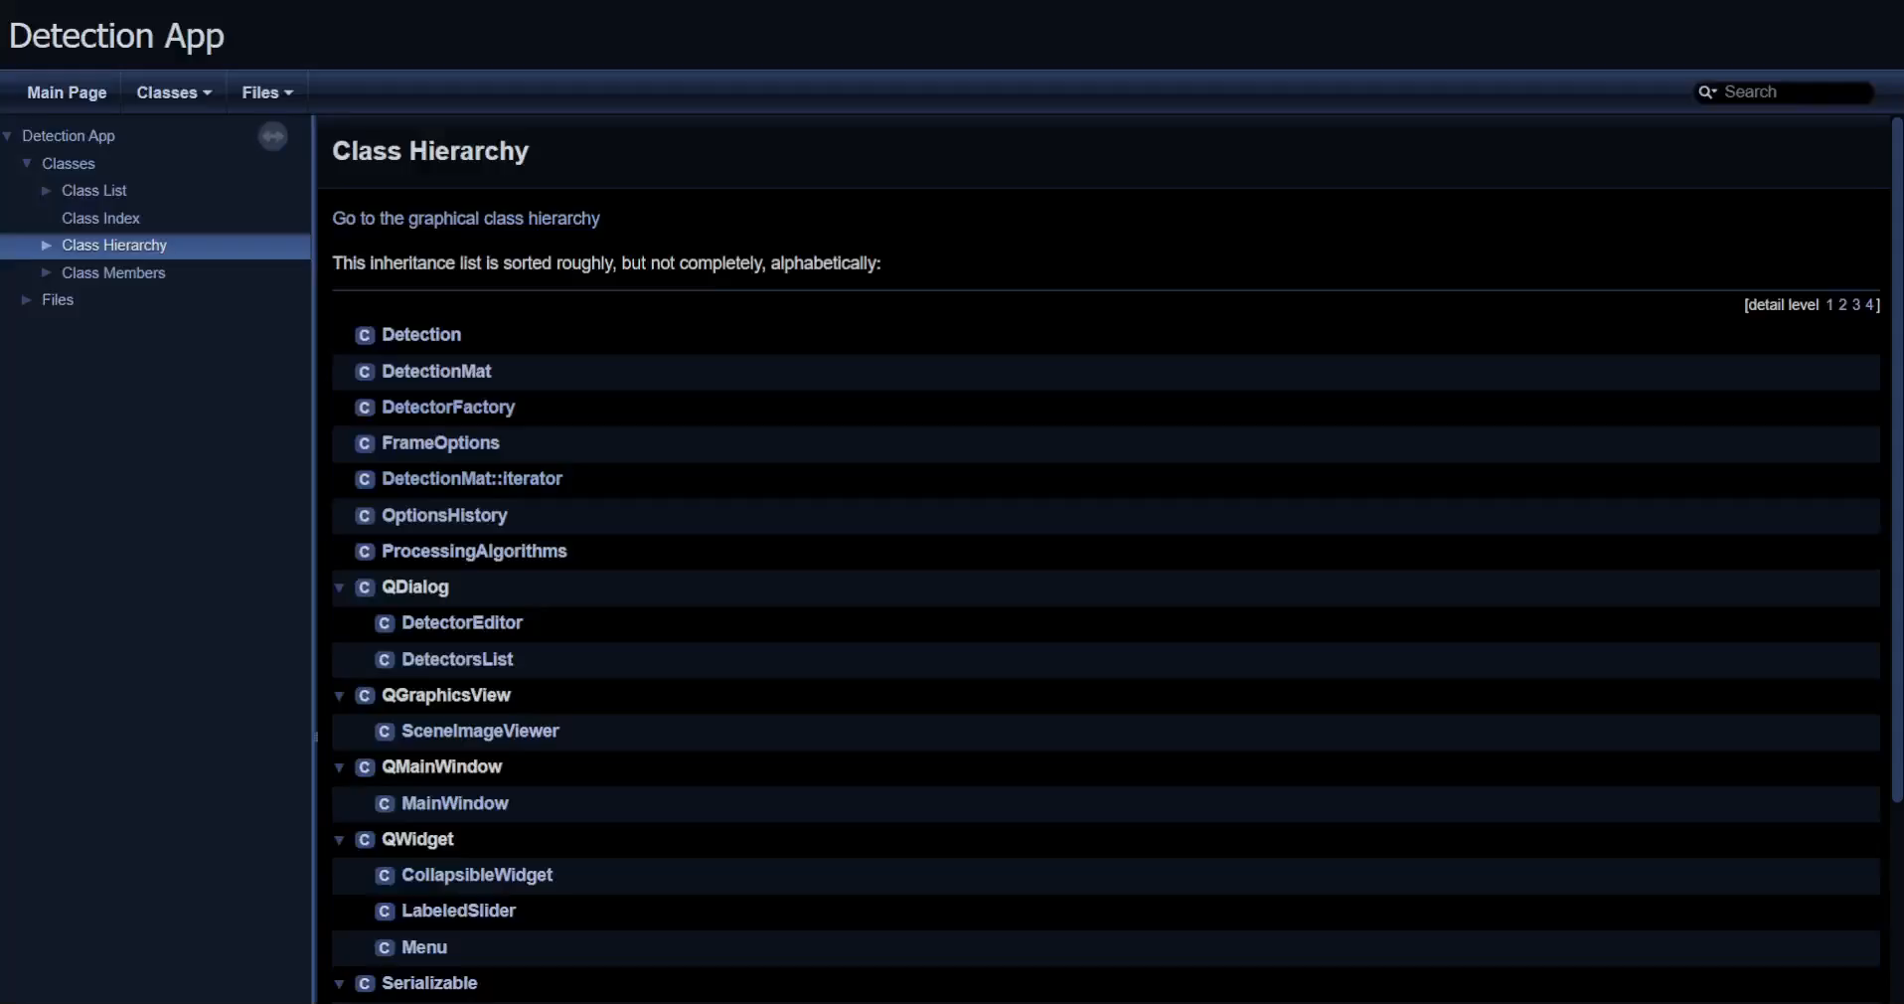
Tests and documentation
To ensure that the application does not encounter any issues, a series of Unit tests have been implemented that individually verify each component.
And to facilitate the understanding and maintenance of the code, Doxygen was used to create the documentation.

Slide 17
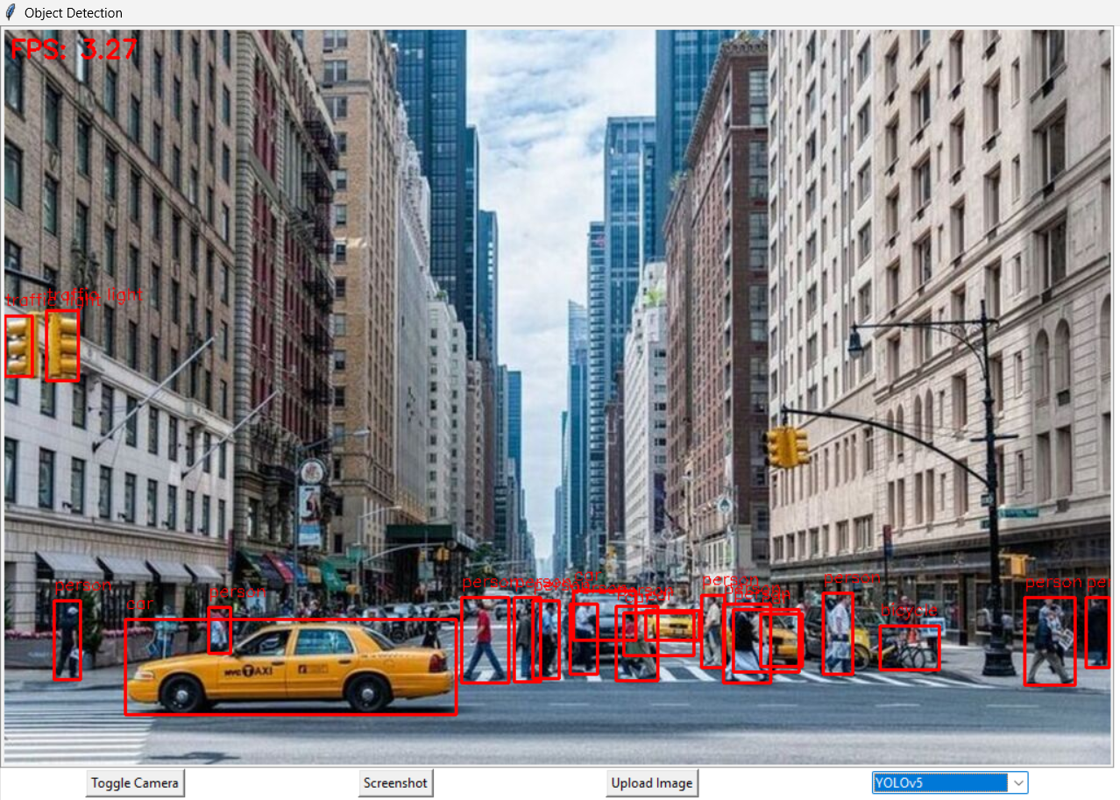
Python project
Python technologies were also experimented with, recreating some functionality of the initial application in this language, for example:
working with video stream or uploaded images
detection with different models
possibility of screenshot
GUI built with Tkinter

Slide 18
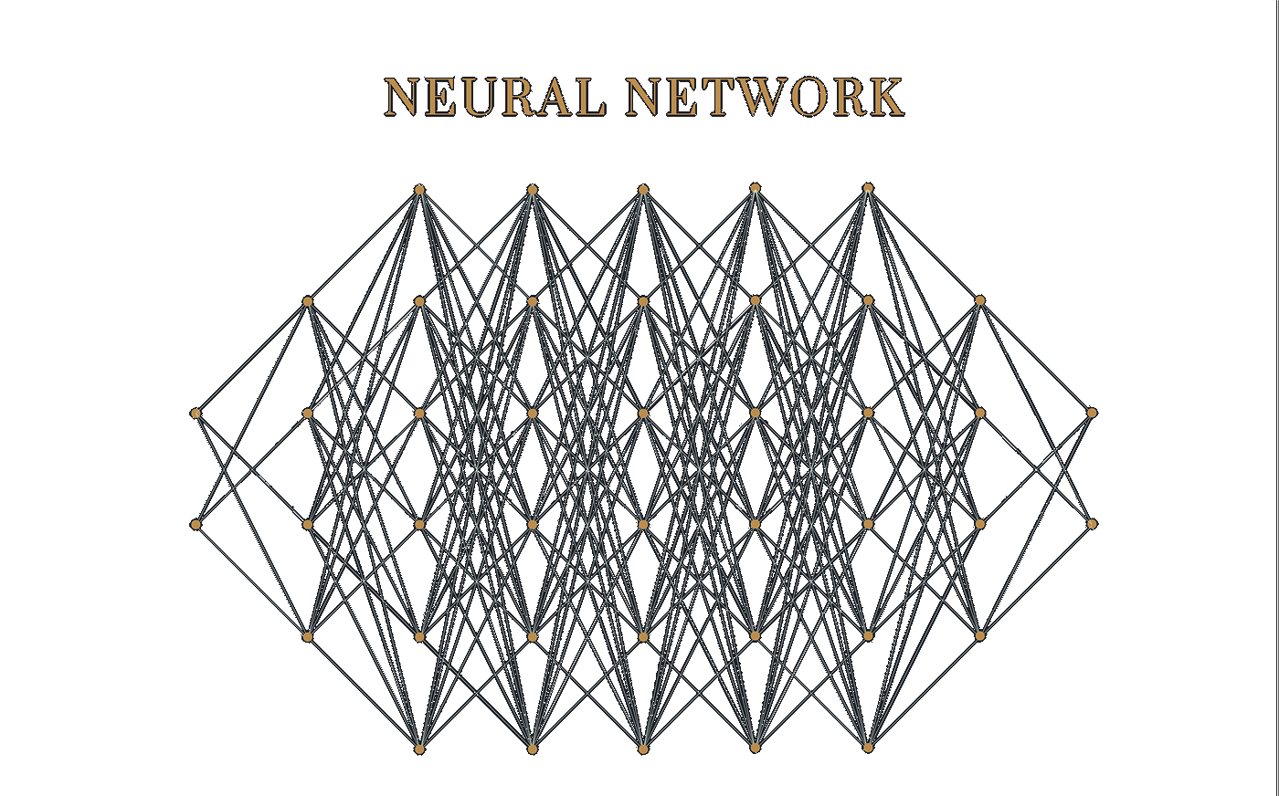
Machine learning
In both the C++ and Python projects, various pre-trained models were employed, including:
Haar cascade detector
MobileNet V3
YOLOv5
Additionally, a custom model was trained for classifying images into specific vehicle types.
Furthermore, a more complex model was trained using 23,000 images and the YOLO architecture. This advanced model excels in detecting and framing objects in urban landscapes, distinguishing between vehicles and persons.

Slide 19
DEMO

Slide 20
THANK YOU!
George Patrașc
MATEINFO – Informatică, an III
Ferencz Cârnu
IESC – Inginerie Electrică și Calculatoare (în lb. engleză), an III

